Slide 1
Support of Land

Slide 2
Lateral Support
Support on the side (e.g., a slope or hill).
General rules:
Absolute liability for actions.
No duty to take affirmative protective steps.
If remove natural support and replace, duty to maintain arises.
Are improvements covered?

Slide 3
Subjacent Support
Support underneath when sub-surface rights separated from surface rights.

Slide 4
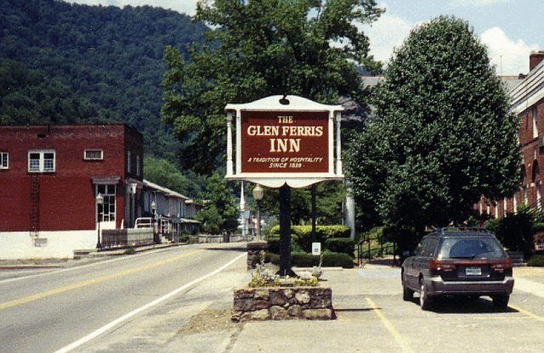
Noone v. Price
Population 250
Notes:
http://members.tripod.com/~jkcummi/glenferris.jpg

Slide 5
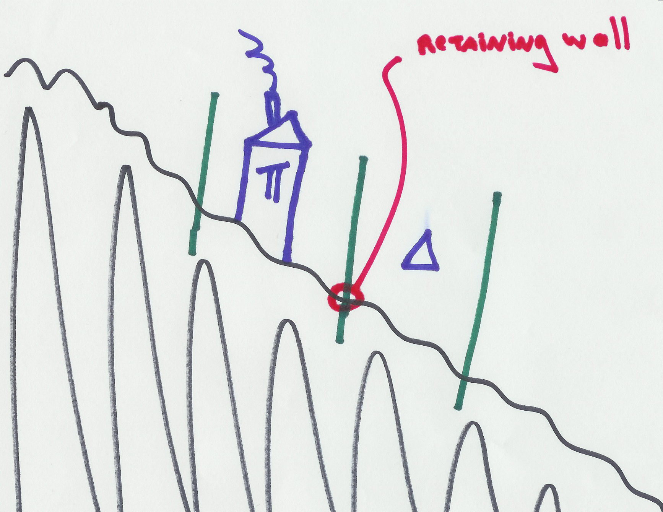
Noone v. Price
Notes:
http://members.tripod.com/~jkcummi/glenferris.jpg

