Slide 1
Property Defined Judicial Opinions

Slide 2
Context = Did conversion occur?
If alleged thing converted is not property in the first place, there can be no conversion recovery.

Slide 3
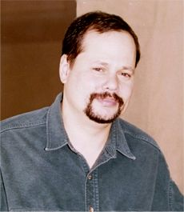
Kremen v. Cohen
Gary Kremen

Slide 4
Kremen v. Cohen
Stephen Cohen

Slide 5
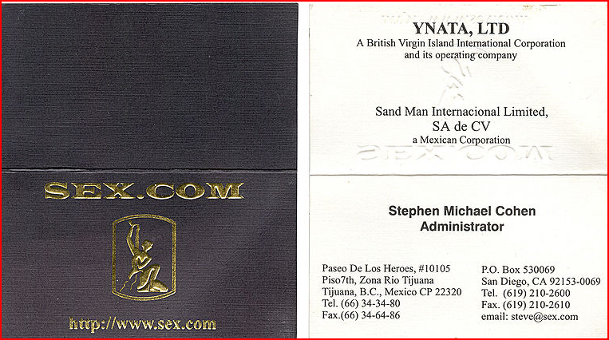
Kremen v. Cohen
Stephen Cohen’s Business Card

Slide 6
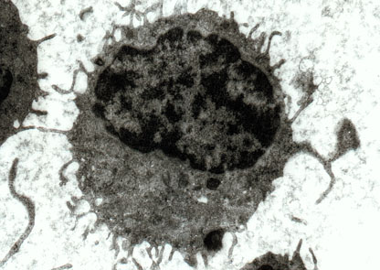
Moore v. Regents
Hairy Cell Leukemia Electron Micrograph

Slide 7
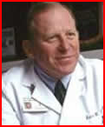
Moore v. Regents
Dr. David W. Golde died 8/8/2004

