Slide 1
Equitable Servitudes

Slide 2
Equitable Servitudes -- Generally
A covenant enforced as running with the land in a court of equity even though it does not meet all the requirements of a real covenant.
Key issue = which requirements may be lacking?

Slide 3
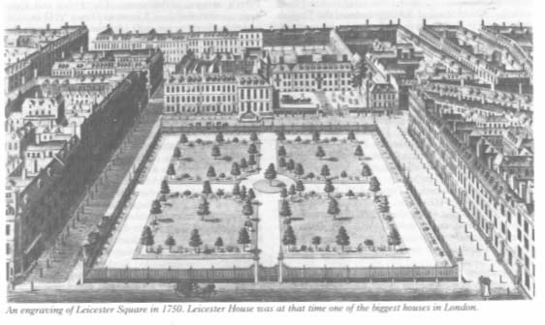
Tulk v. Moxhay
Leicester Square -- 1750
Notes:
http://www.georgianindex.net/London/squares/leicestersq.jpg

Slide 4
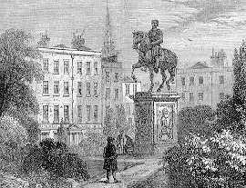
Tulk v. Moxhay
Equestrian Statute -- 1790
Notes:
http://www.speel.demon.co.uk/other/leicestr.htm

Slide 5
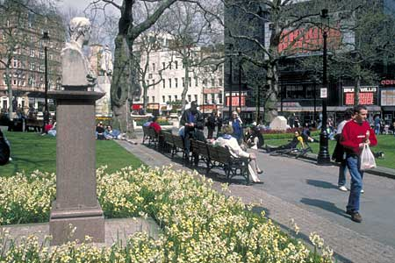
Tulk v. Moxhay
Leicester Square -- today
Notes:
http://www.lozoodiverona.it/photos/Londra%20-%20Leicester%20Square.jpg

Slide 6
Tulk v. Moxhay
Court was willing to relax mutual privity requirement in equity because of notice.
Notes:
http://www.lozoodiverona.it/photos/Londra%20-%20Leicester%20Square.jpg

Slide 7
Equitable Servitudes [continued]

Slide 8
London County Council v. Allen

Slide 9
London County Council v. Allen
Court unwilling to relax benefit must touch and concern land requirement.

Slide 10
Implied Reciprocal Equitable Servitude

Slide 11
Implied Reciprocal Equitable Servitude
1. Lots in residential subdivision originally owned by common owner/developer.

Slide 12
Implied Reciprocal Equitable Servitude
2. Owner/Developer imposed restrictions in deeds of most conveyed parcels.

Slide 13
Implied Reciprocal Equitable Servitude
3. Developer imposes general plan upon subdivision (uniform restrictions on most deeds, recorded declaration, etc.)

Slide 14
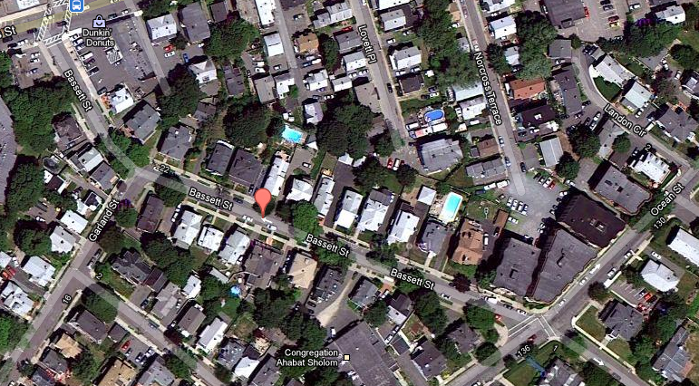
Sprague v. Kimball

Slide 15
Sprague v. Kimball
Kimball (Seller)
Sprague Grossman
(Purchaser (Purchaser
with restrictions) w/o restrictions)

Slide 16
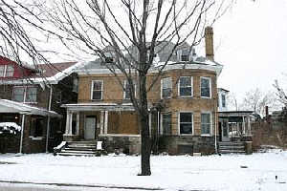
Sanborn v. McLean
House a few blocks away from Collingwood & Second

Slide 17
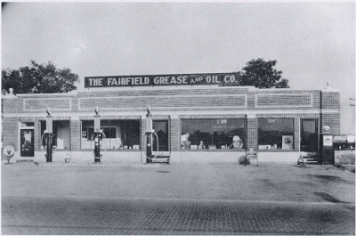
Sanborn v. McLean
Type of gas station McLean wants to build.

