Slide 1

Mid-Term Review Session

Slide 2


Slide 3
Agenda
Format of Mid-Term Exam
Review of intestate succession
Sample intestacy questions
Review of wills
Review of practice objective questions
Review of practice essay question
Open Q & A

Slide 4

Mid-Term Exam – Generally
Friday, March 22 – 1:00 p.m. to 3:00 p.m.
Closed book, closed notes

Slide 5
Objective Questions – 50%
Number = 50
Type
Multiple-choice
Select best answer
Select all correct answers
True/False
Computation

Slide 6
Essay Question – 50%
One fact pattern followed by ten questions
Additional facts added for some of the questions.
Space limited
1,500 words, if using computer
5 pages, if handwriting
Only 50-75% of space is needed for “A” answer

Slide 7
Intestate Succession Review

Slide 8
Intestacy Analytical Framework
1. What law applies?
Personal property = intestate’s domicile at death
Real property = situs of real property

Slide 9
Intestacy Analytical Framework
2. Do particular facts raise issues effecting determination of heirs or disposition?
Half-blooded collateral heirs
Adopted individuals
Non-marital children
[continued]

Slide 10
Intestacy Analytical Framework
[continued]
ART children
Heir murders intestate
Heir fails to survive intestate by 120 hours
Advancement
[continued]

Slide 11
Intestacy Analytical Framework
[continued]
Disclaimer
Non-U.S. citizen
Heir born after intestate’s death

Slide 12
Intestacy Analytical Framework
3. Was intestate married at time of death?
If yes, follow “community” and “separate” property schemes.
If no, follow “individual” property scheme.

Slide 13
Intestacy Analytical Framework
Community Property
1. No surviving descendants
SS inherits all of DS’s community [SS ends up owning all community property].

Slide 14
Intestacy Analytical Framework
Community Property
2. At least one surviving descendant
Only marital descendants = SS inherits all of DS’s community property (SS ends up owning all community property).
At least one non-marital descendant = DS’s descendants inherit DS’s community (SS inherits none of the community; SS still has his/her ½).

Slide 15
Intestacy Analytical Framework
Separate Property
1. At least one surviving descendant
Personal Property
Surviving Spouse = 1/3
Descendants = 2/3
Real Property
Surviving Spouse = Life estate in 1/3
Descendants = 2/3 (outright) plus remainder of SS’s life estate.

Slide 16
Intestacy Analytical Framework
Separate Property
2. No surviving descendants
Personal Property
Surviving Spouse = 100%
Real Property
Surviving Spouse = ½
Parents, siblings, and their descendants = ½ using the individual property scheme.
Note: If no parents or their descendants, then all to SS.

Slide 17
Intestacy Analytical Framework
Individual Property
Descendants
Parents
If one parent predeceased, ½ to surviving parent and ½ to siblings and their descendants.
If no siblings or their descendants, all to surviving parent.
If both parents predeceased, all to siblings and their descendants.
Grandparents and their descendants, etc., etc.
Escheat

Slide 18
Intestacy Analytical Framework
Type of Distribution
Per stirpes
divide into shares at first generation
Per capita with representation
divide into shares at first generation with survivors
Texas approach
Per capita at each generation
divide into shares at first generation with survivors but then pool shares created for deceased members

Slide 19
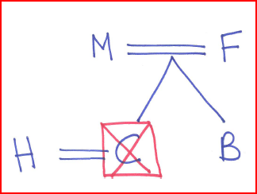
Intestacy Practice Questions
1.

Slide 20
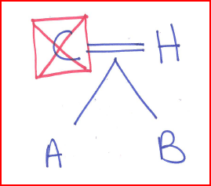
Intestacy Practice Questions
2.

Slide 21
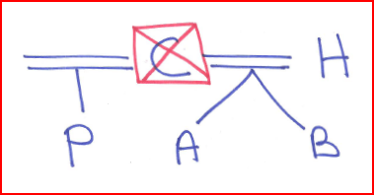
Intestacy Practice Questions
3.

Slide 22
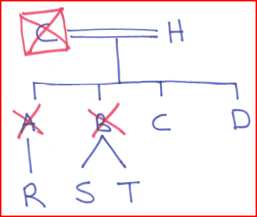
Intestacy Practice Questions
4.

Slide 23
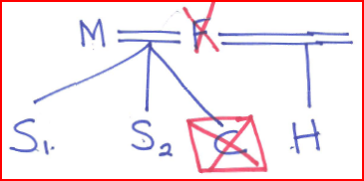
Intestacy Practice Questions
5.

Slide 24
Wills Review

Slide 25
Wills Analytical Framework
1. Is will valid?
Legal capacity
18 years old
Married or divorced
Active duty military

Slide 26
Wills Analytical Framework
1. Is will valid?
Testamentary capacity
Understand what doing
Understand effect of what doing
Know nature and extent of property
Know natural object of bounty (heirs)
Do above simultaneously

Slide 27
Wills Analytical Framework
1. Is will valid?
Testamentary intent

Slide 28
Wills Analytical Framework
1. Is will valid?
Formalities – Attested will
In writing
Signed by testator (or proxy)
2 witnesses
Above 14
Competent
Publication not required
Attest in testator’s conscious presence
Beneficiary as witness may lose some or all of gift

Slide 29
Wills Analytical Framework
1. Is will valid?
Formalities – Holographic will
In testator’s handwriting (surplusage approach)
Signed by testator
No witnesses needed

Slide 30
Wills Analytical Framework
2. Can will be contested?
Not meet requirements
Insane delusion
Undue influence
Duress
Fraud

Slide 31
Wills Analytical Framework
3. If will invalid (or does not dispose of entire estate), do intestate distribution.

Slide 32
Wills Analytical Framework
4. If will valid, was it revoked (partially or totally)?
By operation of law
Divorce
Pretermitted child
Beneficiary predeceases (biologically or legally) (lapse)
Property not in estate (ademption)
By physical act (total only)
By subsequent writing (partial or total)

Slide 33
Wills Analytical Framework
5. If will valid, look for following issues regarding proper distribution of property:
Ademption of specific gifts
Satisfaction of gifts
Effect of change in value
Interest on pecuniary gifts one year from death
Exoneration (not presumed)
[continued]

Slide 34
Wills Analytical Framework
[continued]
Abatement
Apportionment (taxes)
Divorce
Pretermitted children
Lapse (anti-lapse; cy pres)
Ambiguities (latent, patent, no apparent)
[continued]

Slide 35
Wills Analytical Framework
[continued]
Integration (external & internal)
Incorporation by reference
Facts of independent significance
Precatory language
Class gifts
Conditions (entire will or specified gift)
Combination wills (joint, reciprocal, contractual)
Election will

Slide 36
Practice Questions

Slide 37
Objective Sample Select best answer
Father made an inter vivos gift to Daughter for $25,000. Father died intestate survived only by Daughter and Son with a distributable estate of $75,000. If Son receives $50,000 from Father’s estate, which one of the following would be the most likely explanation?
Father’s gift to Daughter was a satisfaction.
Father’s gift to Daughter was an advancement.
Daughter executed a valid disclaimer of her entire intestate share.
Father’s gift to Son was augmented following the doctrine of dependent relative revocation.

Slide 38
Objective Sample Select all correct answers
Which of the following is/are correct statements regarding will formalities and will execution? Select all correct choices.
Nuncupative wills need to be signed by at least two credible witnesses.
A will written in pencil is unwise but would nevertheless satisfy the writing requirement.
Most states require three witnesses for a valid will.
The testator and witnesses should execute a self-proving affidavit.

Slide 39

Practice Essay Question

Slide 40
Practice Essay Question
1. Validity of Will
Proxy signature

Slide 41
Practice Essay Question
2. Validity of “Bequests at my death” document.
Holographic will?
Incorporation by reference?
Fact of independent significance?

Slide 42
Practice Essay Question
3. Natalie’s Gifts

Slide 43
Practice Essay Question
4. Partial intestacy
Julie – adopted so treated as biological
Birthday gift not an advancement as not in writing.

Slide 44
Practice Essay Question
5. Natalie’s Intestate Share
Separate = 1/3 ($100,000)
Community = none (Kevin is not Natalie’s descendant)

Slide 45
Practice Essay Question
6. Julie’s and Kevin’s intestate shares
Separate – each receives $100,000
Community – each receives $50,000

Slide 46

Questions?

